Slide 1
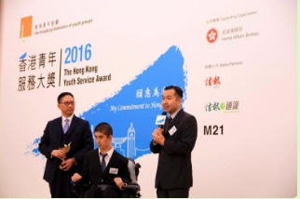
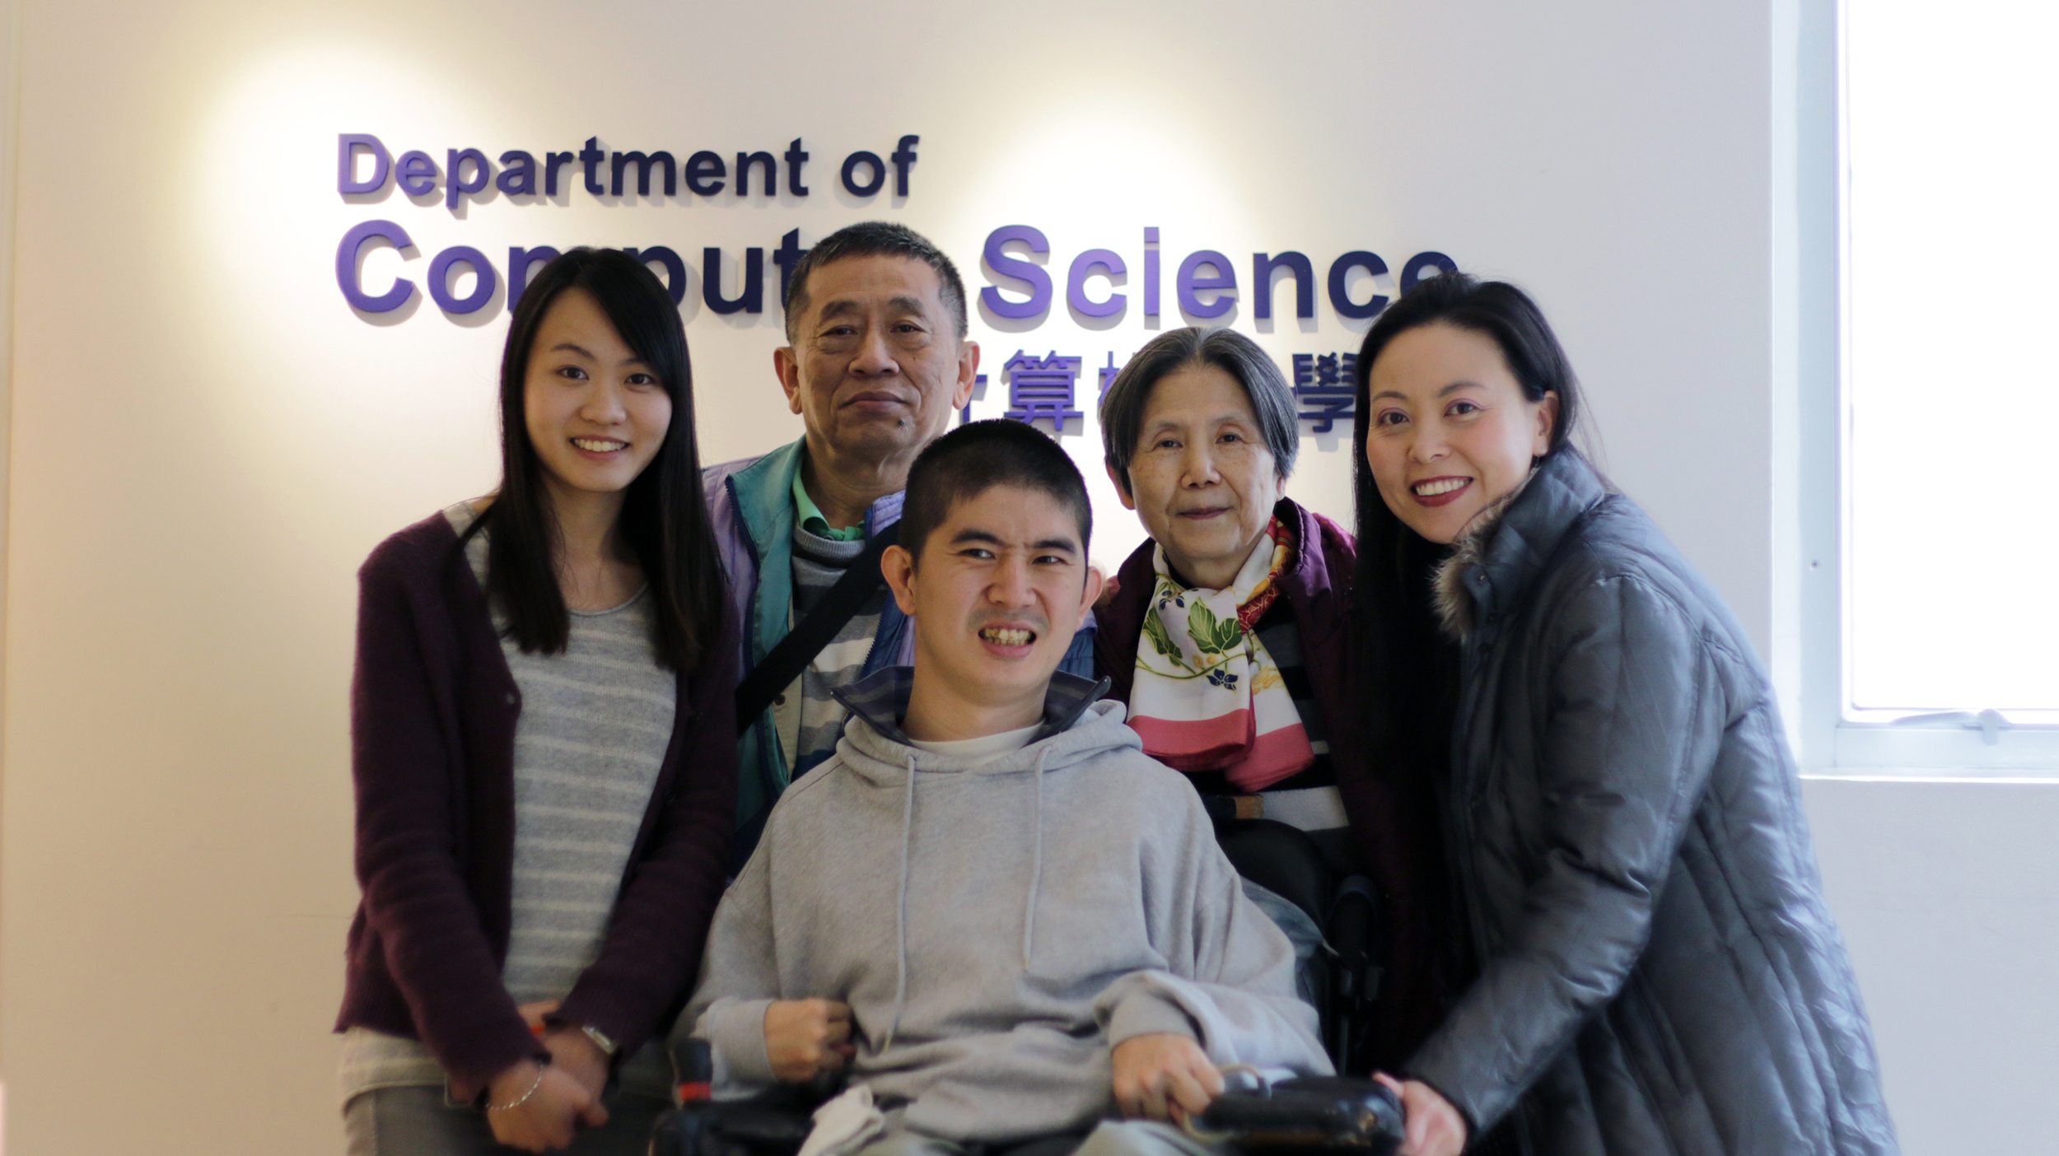
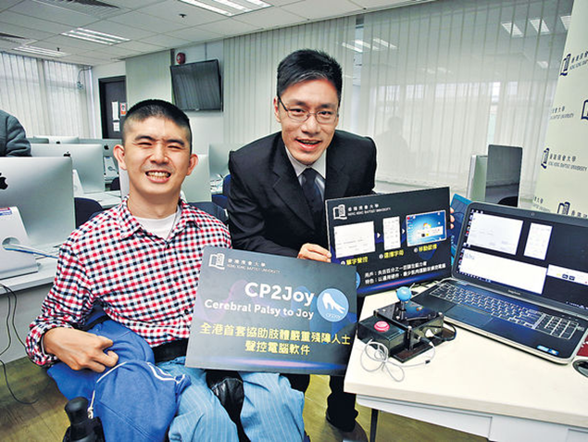
CHEUNG Sai Ho (Sunny)
LMU UK, BSc 1st hons, VTC HK HDip, P.Cert, HKBU MSc. Research AIS 2019
TSSSU Awardee 2020-22, HKSTP IncuTech Winner 2020-23
CP2Joy IT CO. LTD Founder

Slide 2
Self-introduction
My brain was damaged at birth seemingly due to a bad medical decision made during delivery. Since then, I have been suffering from Athetoid Cerebral Palsy (CP). Being severely disabled, I could not receive normal education. Instead, I had special education (P.1 to F.7) at The Hong Kong Red Cross Association of John F. Kennedy Center, (JFKC) dedicated for physically disabled children.
As a CP patient, my muscle tone is very unstable, with my both hands functioning poorly while I am bound to the wheelchair all the time. Moreover, my speaking ability is almost helpless. So, I need to put in extra efforts and much more time in order to finish my work and study.
Special education has been very fruitful. It has provided me with comprehensive life skill training for the past eighteen years. Today, I can drive my electric wheelchair going out with my family and friends, and I can type with one finger. I finished pursing my degree course with excellent academic results. I also worked and established my IT company in the past few years.

Slide 3
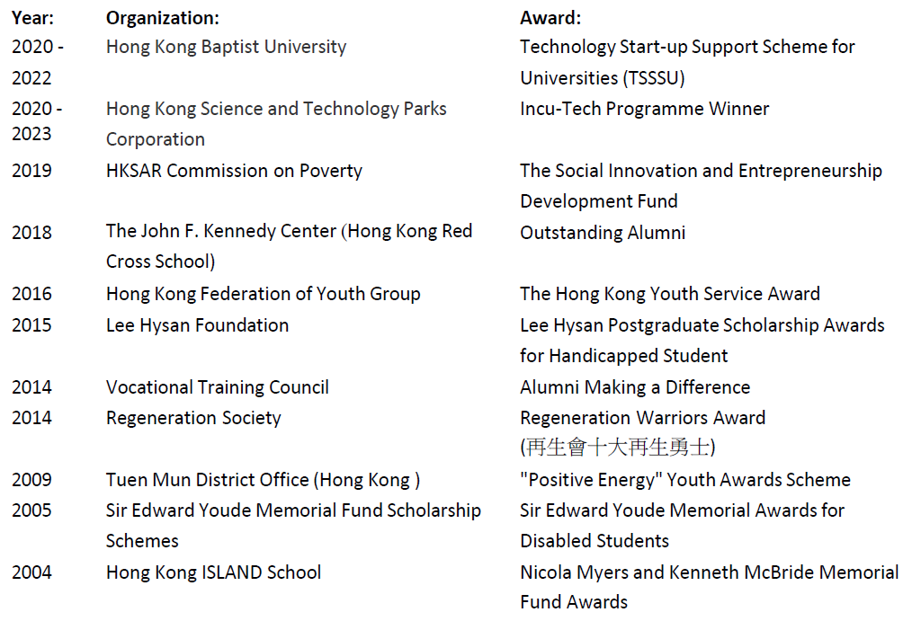
Awards

Slide 4
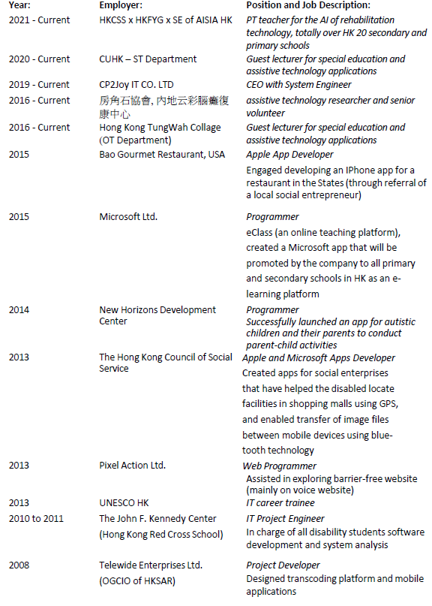
Working experience

Slide 5
Challenges of my study in HKBU – Examination
Special arrangements for disabled students
60% of questions multiple-choice style or just for short answers
An amanuensis was appointed to write for me
People can't understand what I say, given my speech disability
Great difficulty to pronounce clearly letters like ‘b, d, g, t, p, s, x, m, n’, which became a burden for my amanuensis
Situation got worse when time was pressing and muscle control failed when I became nervous.
Yet I needed to spell out the whole word letter by letter when the amanuensis could not tell what I said. It was painful for both of us until our cooperation paid.

Slide 6
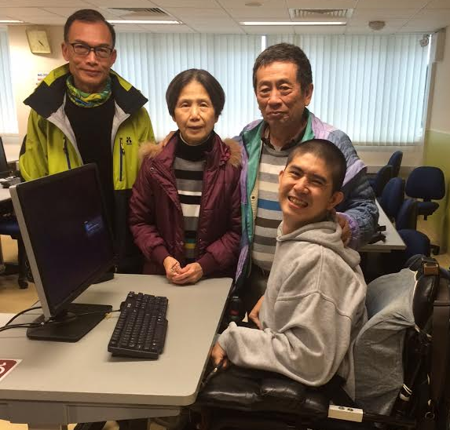
Difficulties faced in examination
Negotiation with faculty for special arrangements like question mode and extra time
Assessment from occupational therapist
More questions set in MC mode, with deduction for wrong answers
Entire process video recorded.

Slide 7
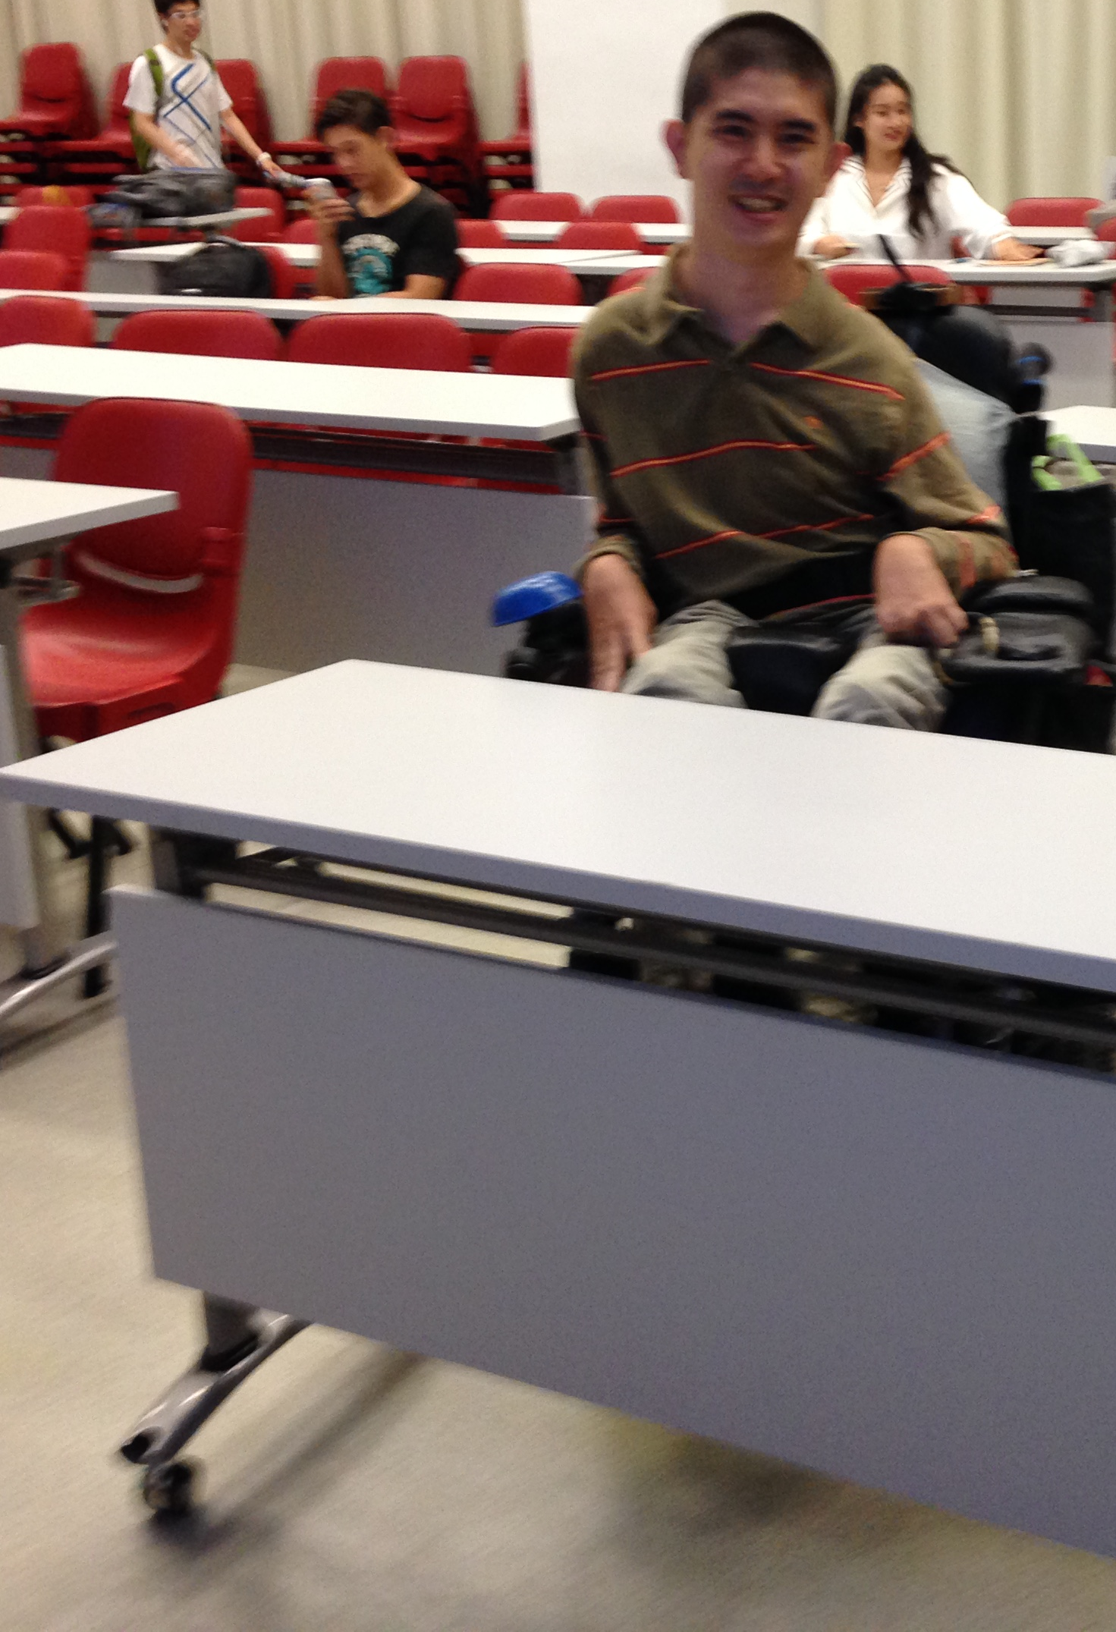
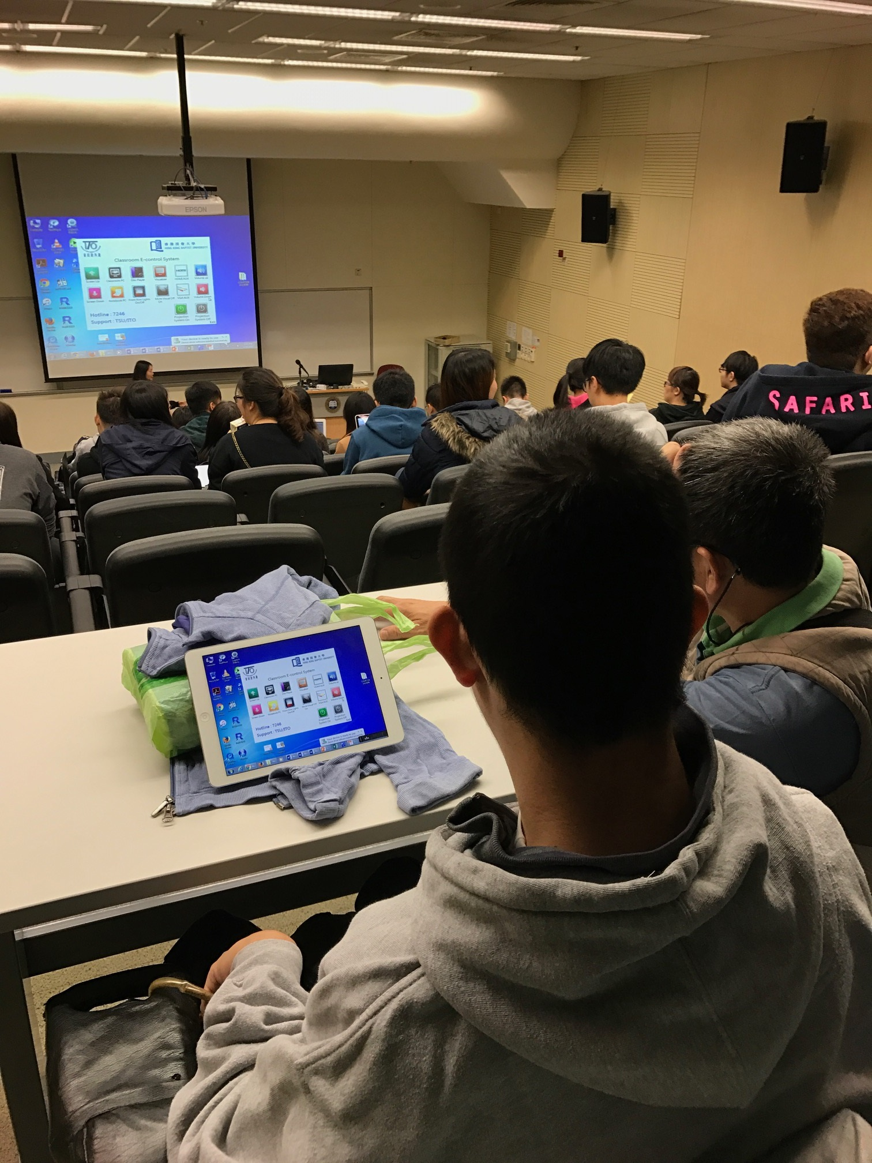
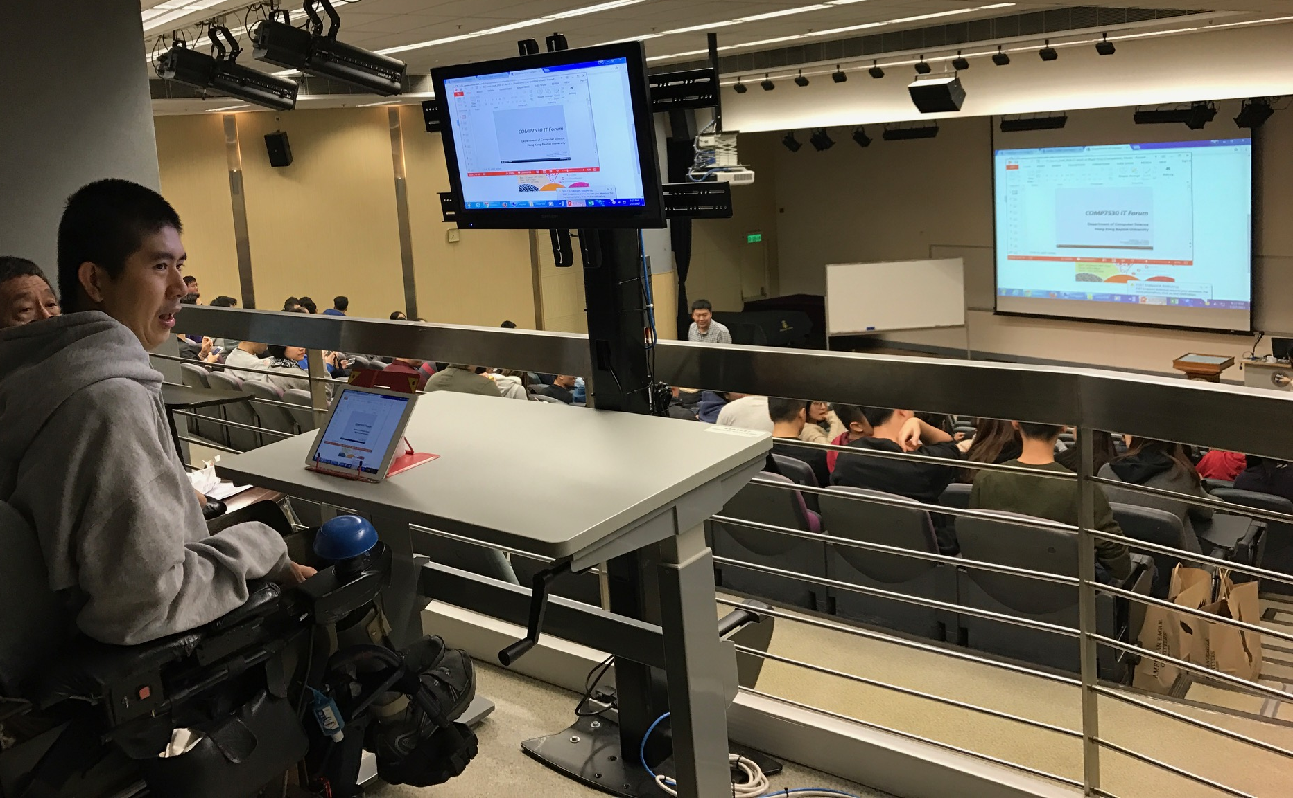
Difficulties faced in the classroom
wheelchair bound students don’t always get a good view due to limitations in different classrooms
Slashtop Classroom: software to duplicate projector screens onto my pad
a higher table for my wheelchair to park!

Slide 8
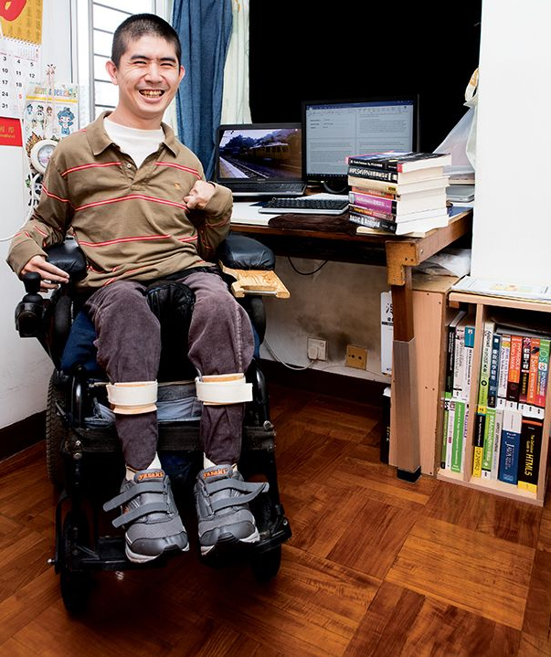
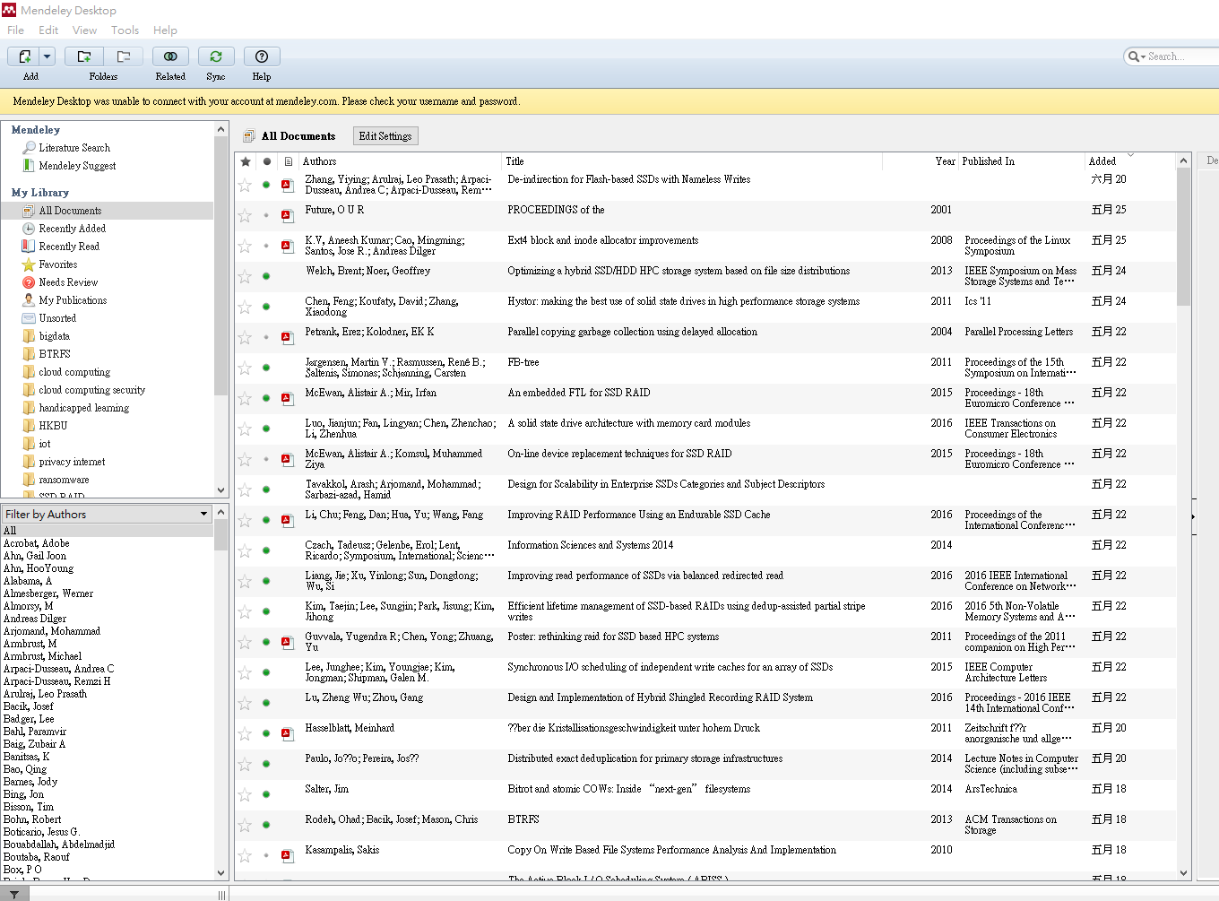
Difficulties in Self Study
Research begins with intensive searches, from library to library, from picks to collect, from scans to reviews, dead focus to gain progress
demanding master program study, plus social and volunteer work, leaving little time to go out
long days everyday preparing for thesis

Slide 9
CP2Joy project - A Cooperation with Professor Byron Choi
Enrolled in the MSc Practicum, a project based module with no examination, unlike other taught based modules
Flexible assessment method, with my system development work and research report based on a special schedule
Deep thanks to Professor Byron, for allowing me to start working around 18 months earlier. I tried my best and got excellent results.
Discussion with Prof on the right research approach and system development methodology from time to time, and comparison of various assistive technology tools by pros and cons.
Definitely extreme hard work leveraging strong problem solving skill amid a always positive thinking attitude
Student ability and determination → More flexible time → doing more research and findings → buildup good cooperation with supervisors → earn wonderful research experience and good academic result.

Slide 10
Current development of CP2Joy
- HK short-term patent filed on 25 March 2021, HK30032737
Joined public exhibitions in HKCEC for 3 years, e.g. GIES
Apply several HKSAR research funds including SIE startup, HKBU TSSSU, HKSTP IncuTech programme totalled over HKD 1.5M
Sales income around HKD 80k, clients including HK, mainland NGOs, Tung Wah College and HKU Department of Education etc.
30+ media have reported my story and my company
TSSSU promotional video: https://youtu.be/7bhxJBxxOf4

Slide 11
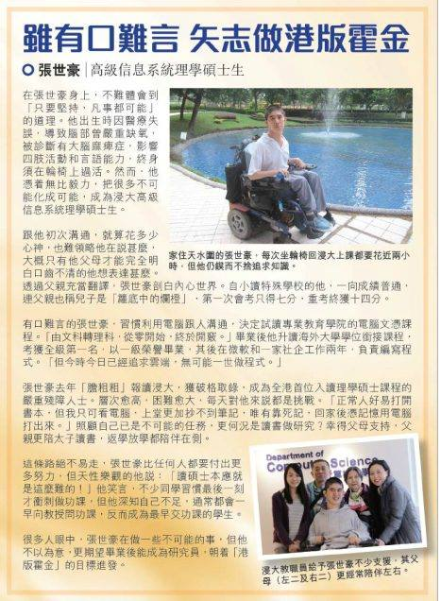
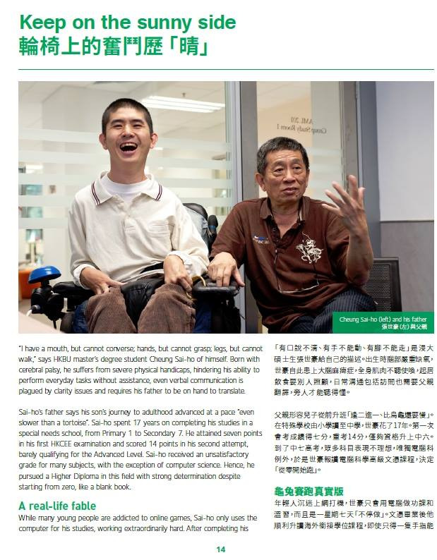
Special columns in HKBU publication and 60th anniversary
HKBU BUddy Post_People Wisdom
HKBU Horizons Magazine 1617 Issue vol.2 - [浸大俊彥]P.14-15
浸大60年校慶專訪 – Am 730, 頭條日報

Slide 12
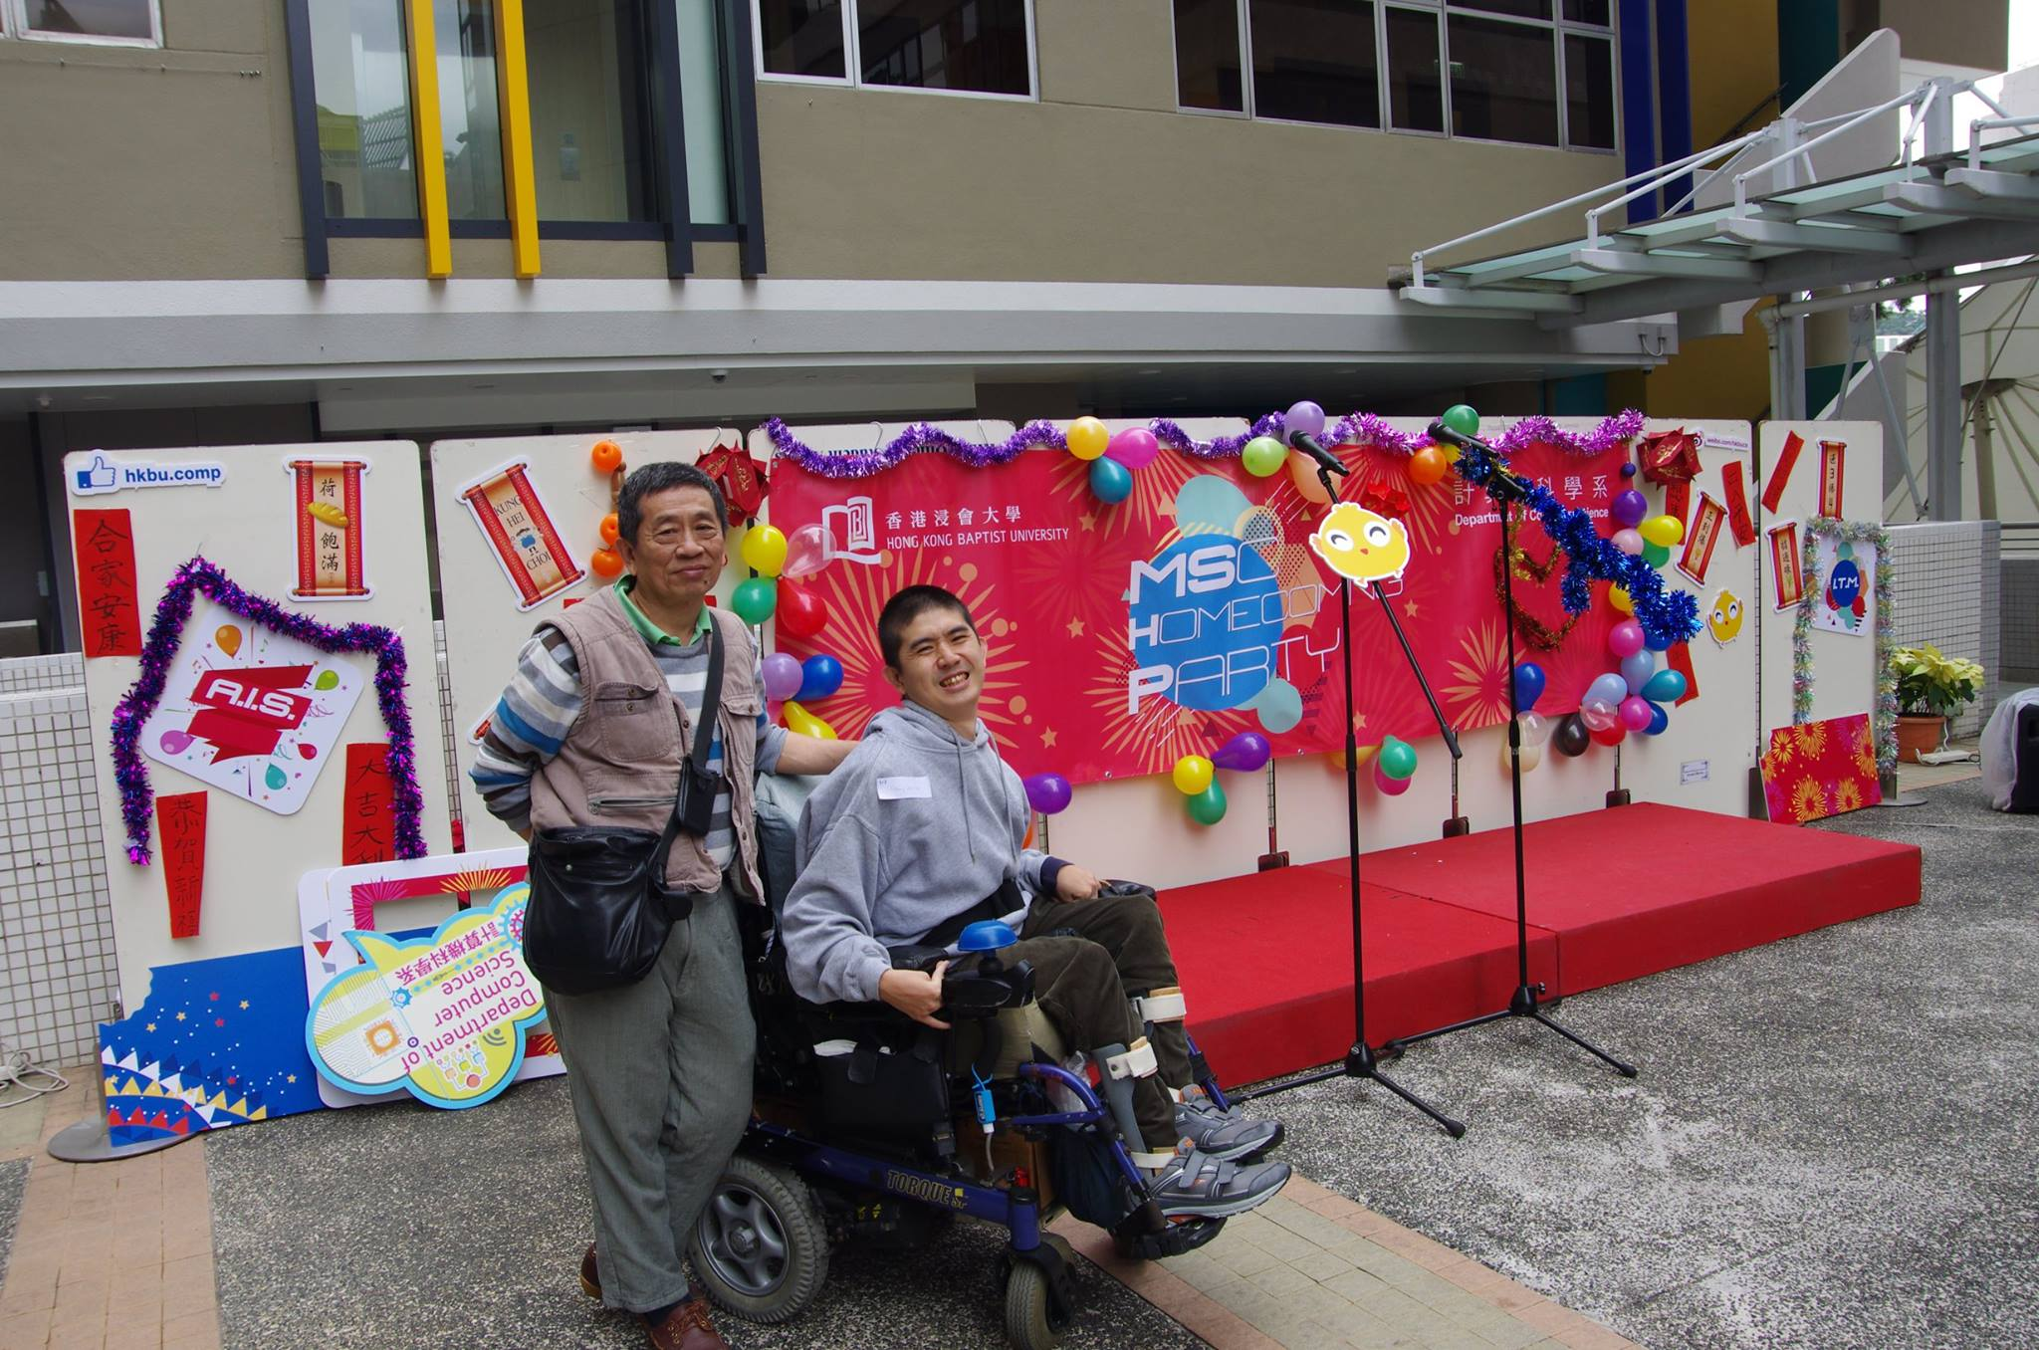
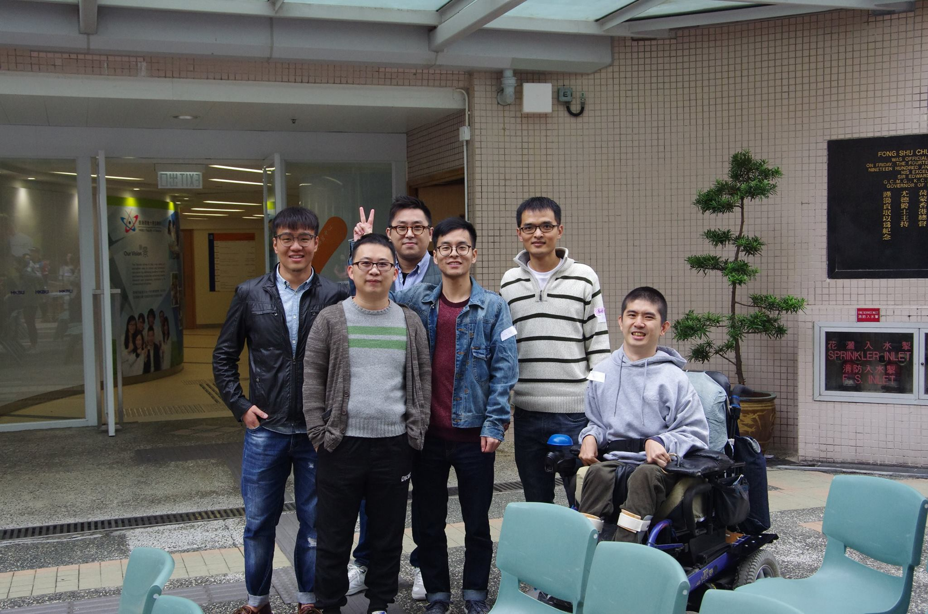
Enjoining my wonderful university life with lecturer and classmates

Slide 13
About me….
http://www.sunit2u.com/
Q&A, thanks for all

